Slide 1
Transcranial Photoacoustic Computed Tomography
Joseph Kuo

Slide 2
Outline
Overview of limitations existing brain imaging modalities.
Introduce a novel imaging modality known as Photoacoustic Computed Tomography (PACT)
Challenges in the reconstruction process in PACT.
Formulation of an imaging model.
Apply the imaging model in a reconstruction framework.

Slide 3
Overview of Brain Imaging
Neuroimaging technologies play an increasingly important role in the initial detection and subsequent monitoring of brain diseases [Kang 2014 et al.].
Examples of diseases:
Traumatic brain injury
Tumors
Stroke
Parkinson’s
Available imaging modalities include:
X-Ray Computed Tomography (CT)
Positron Emitted Tomography (PET)
Magnetic Resonance Imaging (MRI)
Diffuse Optical Tomography (DOT)
Ultrasound

Slide 4
Limitations of Existing Modalities
X-Ray CT exposes the patient to ionizing radiation and has poor soft tissue contrast.
PET exposes the patient to ionizing radiation and has a poor spatial resolution.
MRI provides excellent soft tissue contrast; however, it requires expensive equipment and has long imaging times.
Ultrasound can possess high spatial resolution, but image quality is severely degraded due to the round-trip acoustic transmission through the skull.
DOT provides excellent contrast based on the optical absorption of hemoglobin; however, it suffers from poor spatial resolution in transcranial imaging.

Slide 5
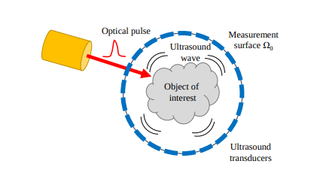
Photoacoustic Computed Tomography
A short optical pulse irradiates the object.
A portion of the light is absorbed by the object of interest, which induces theroelastically induced pressure waves.
These pressure waves propagate as acoustic waves which are measured by ultrasound transducers.
The measured wavefield data is then used to reconstruct an image of the photoacoustically induced initial pressure distribution.
Schematic of a PACT imaging system. This was adapted from [1].
[1] Poudel, J. "Three-dimensional Image Reconstruction in Transcranial Photoacoustic Computed Tomography." (2019).

Slide 6
Advantage of PACT for Transcranial Imaging
PACT involves no ionizing radiation.
PACT provides excellent optical contrast.
PACT provides excellent spatial resolution, like ultrasound, due to the conversion from light to sound.
PACT avoids the round trip acoustic transmission through the skull; however, the one-way acoustic transmission still reduces image quality if not modeled.
The goal of my research project aims to develop reconstruction algorithms that compensate for wave propagation through the skull.

Slide 7
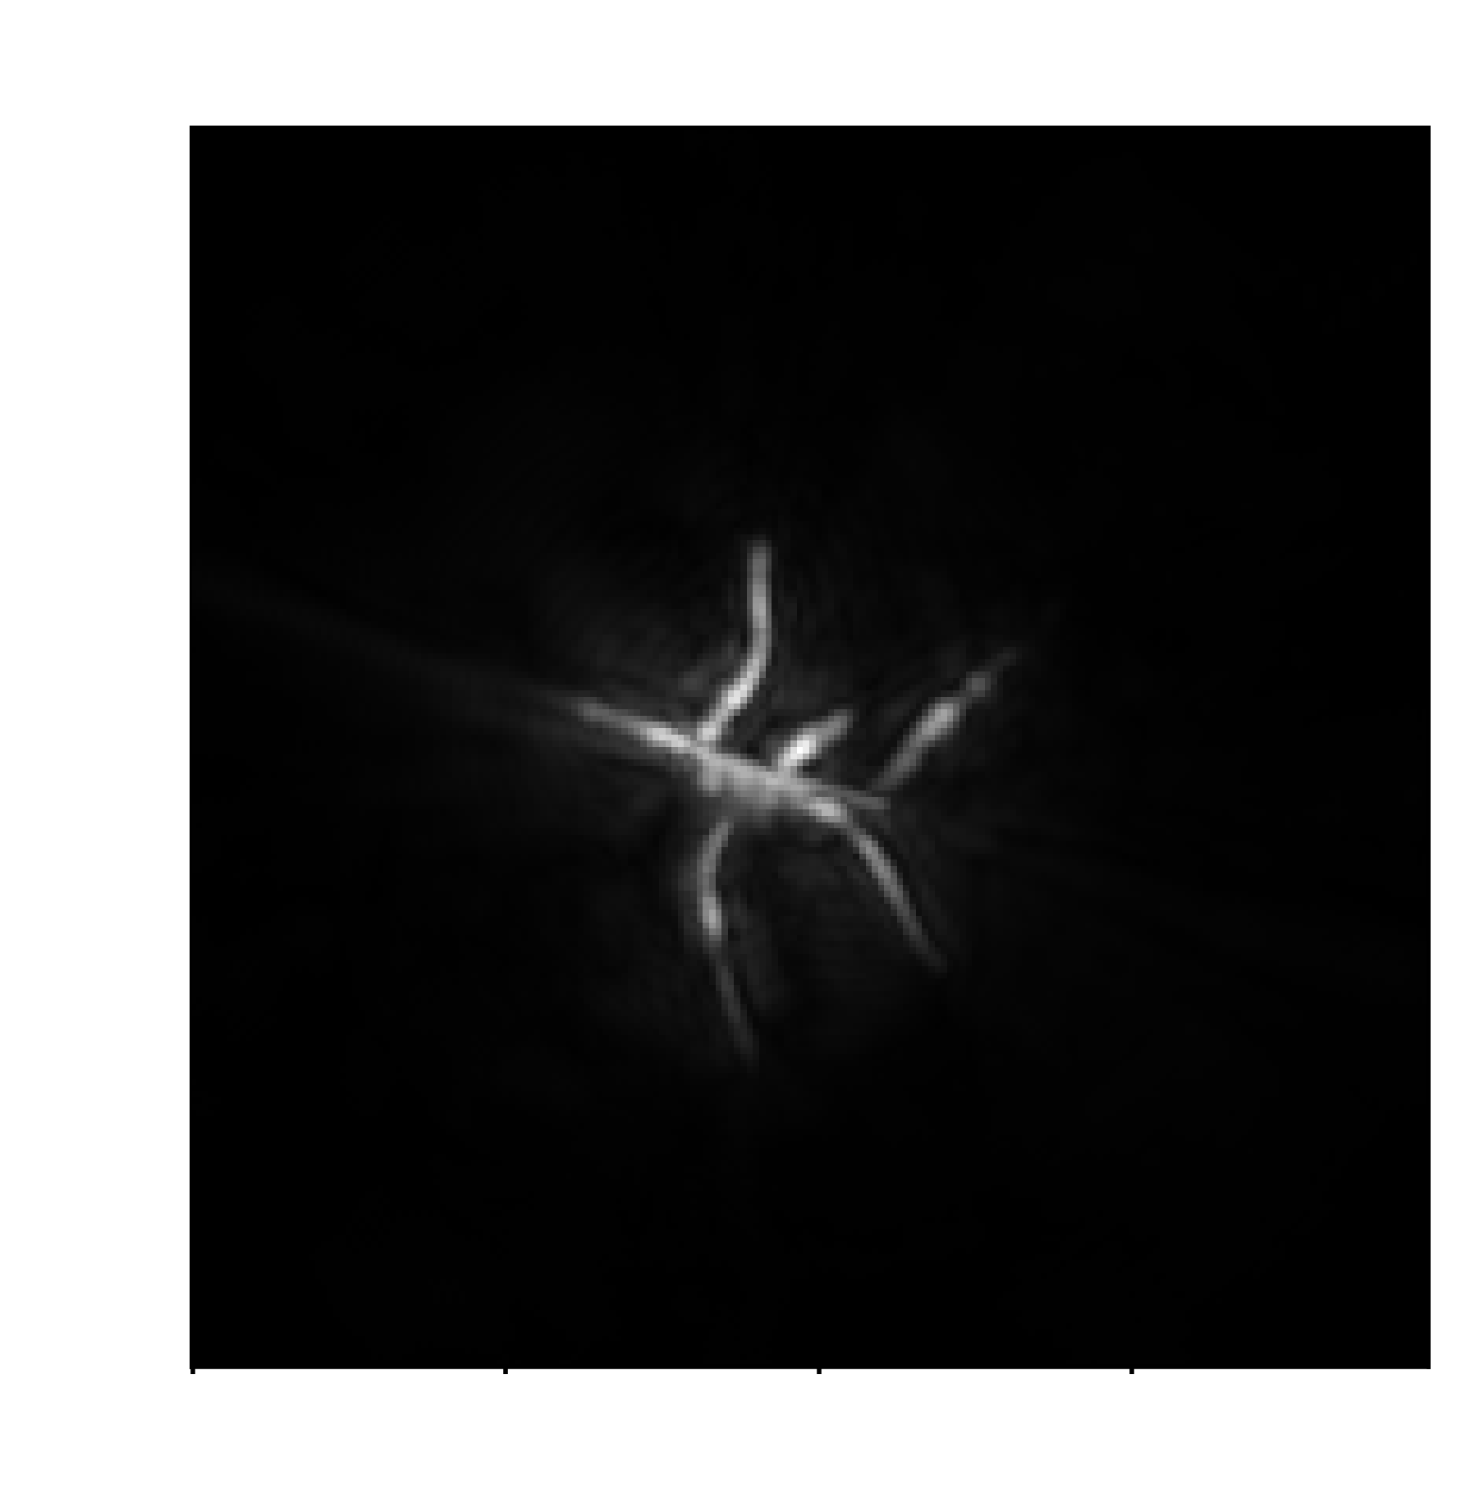
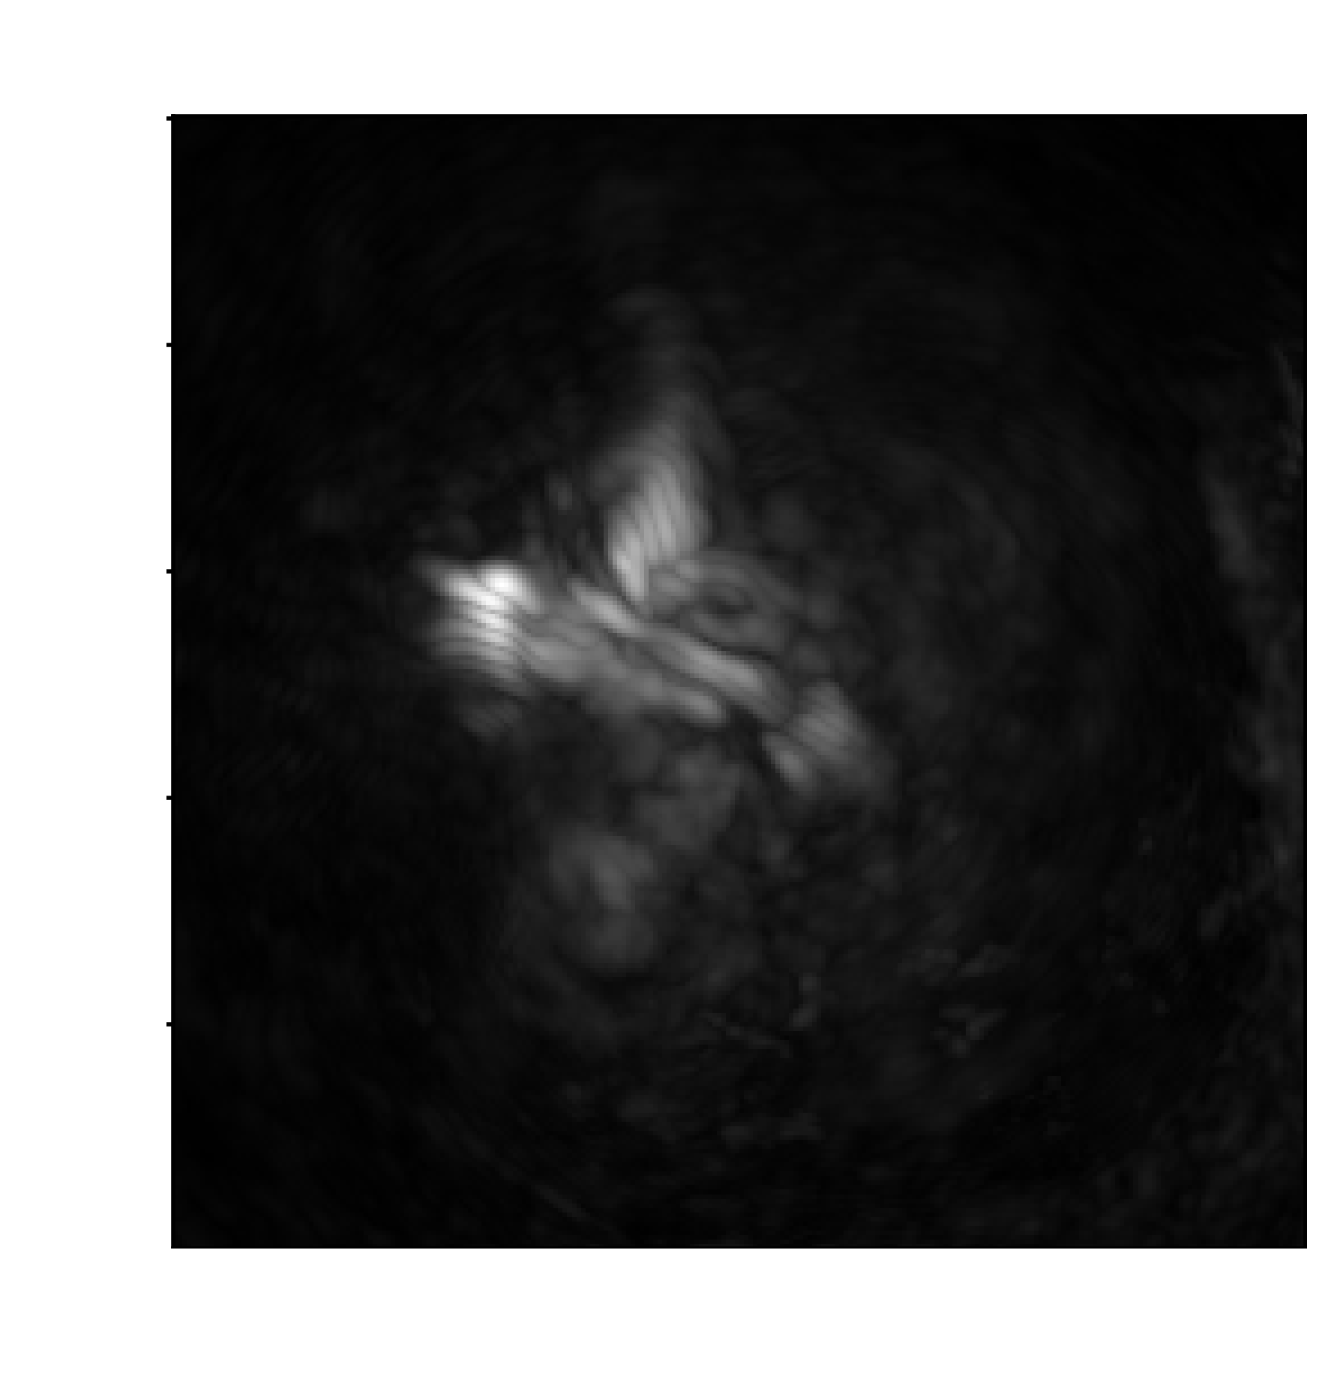
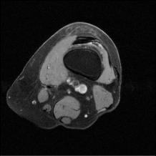
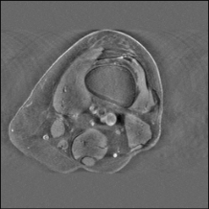


Limitations of Existing PACT Reconstruction Algorithms
Computationally efficient image reconstruction, such as the universal backprojection (UBP) method, have been developed under the assumption of the homogenous acoustic medium.
This assumption is violated in human transcranial imaging.
Human cranial bones are better characterized as elastic solids than fluids [Fry and Barger 1978].
At the fluid-solid interface, acoustic waves undergo longitudital to shear wave conversion, absorption, and scattering.
On the left is an image reconstructed with the UBP method in the absence of the skull. On the right is an image reconstructed with the UBP method in the presence of the skull.
Code (Implicit)
Encoder
Decoder
Flatten
Reshape

Slide 8
Overview of Approach
To model acoustic propagation in the skull, an imaging model based on the elastic wave equation will be used.
An imaging model based on the elastic wave equation will account for longitudinal-to-shear mode conversion and scattering.
This imaging model can compensate for skull-induced aberrations in the measured PACT data.
Code (Implicit)
Encoder
Decoder
Flatten
Reshape

Slide 9








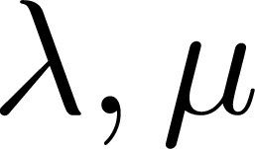
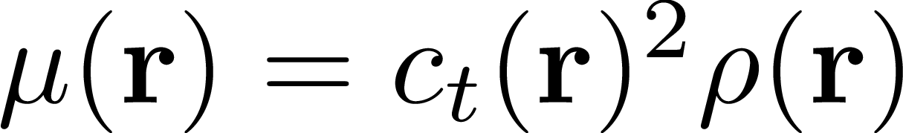
Elastic Wave Equation
For a linear, isotropic, heterogenous medium, the elastic wave equation can be modeled as the following:
Here:
, spatial coordinates
, time
, particle displacement
, density
, stress tensor
, Lame’s first and second parameters
, Identity matrix
, trace operator
, gradient operator

Slide 10
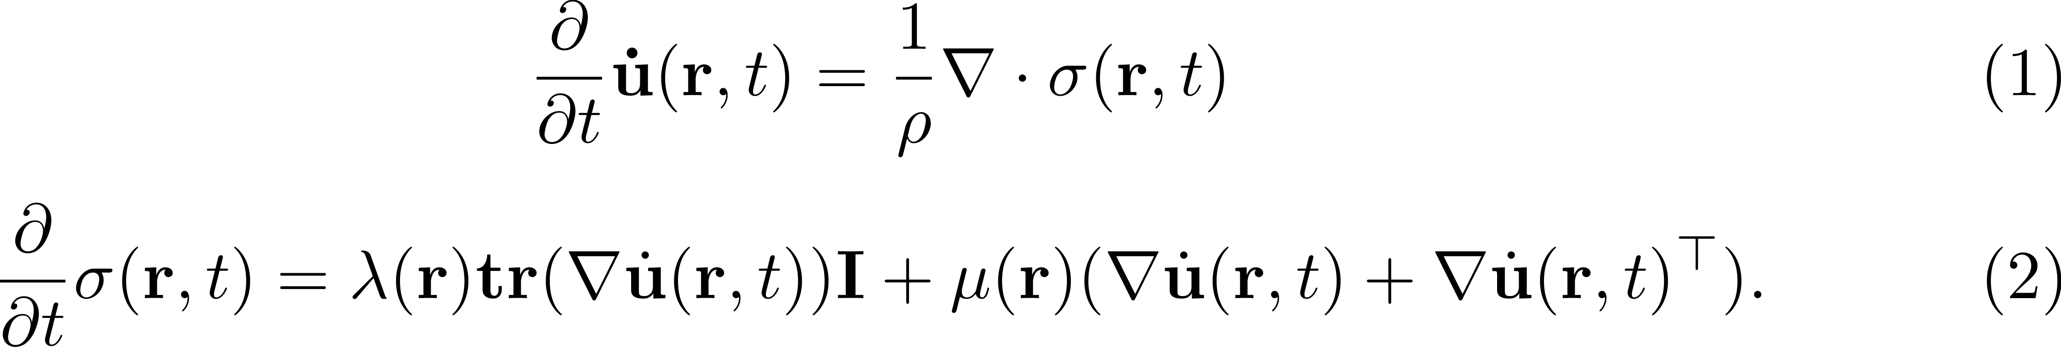
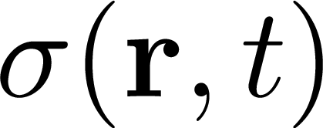
Velocity-Stress Formulation
Alternatively, the elastic wave equation can be written as a pair of first order differential equations.
PACT Initial Conditions (assuming that the object is in the fluid domain):
Where:
, stress tensor
Efficient and accurate numerical methods have been developed to solve this system of equations.

Slide 11
Discretization of Wave Equation
Discretizing the wave equation is not trivial.
This is not an in-depth review!
Popular methods include:
Finite-difference-time-domain method.
Object is represented on a structured grid.
Spatial derivatives are computed using finite-differences.
Pseudo-spectral-time-domain method.
Object is represented on a structured grid.
Spatial derivatives are computed using a Fourier collocation spectral method.
Finite-element-time-domain method.
Object is represented on an unstructured grid.
Velocity and stress values are expanded in each element using vector basis functions.

Slide 12
Finite Difference Time Domain Method
Finite Difference Time Domain (FDTD) method is a popular algorithm for the wave equation.
In the FDTD method, finite difference equations are used to approximate derivatives, which convert a set of partial differential equations into a set of algebraic equations (Moczo 2002).

Slide 13
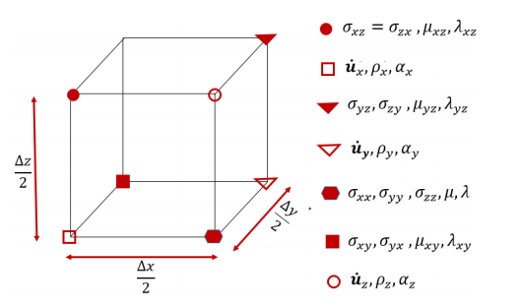
FDTD Staggering
However, evaluation FDTD on the conventional grid suffers from stability and grid dispersion issues when modeling media with a high Poisson ratio [ph].
Poisson ratio is related the longitudinal to transverse velocity ratio.
For example, water is considered to have a high Poisson ratio.
To address this (Virieux, 1986) proposed to evaluate the velocity and stress formulation of the elastic wave equation components a staggered grid.

Slide 14
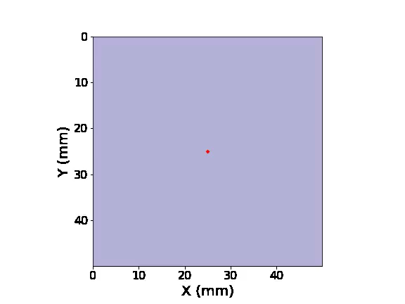
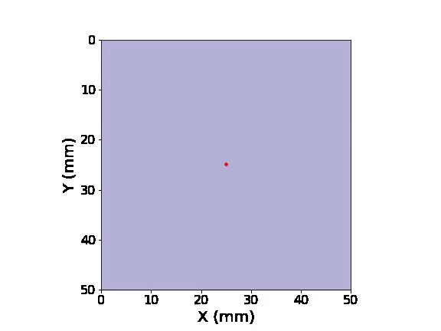
Numerical Dispersion
Furthermore, the choice of spatial step size must choose carefully to avoid numerical dispersion.
Numerical dispersion occurs when the phase and group velocities on the discretized grid differ from the true velocities on the medium.
This is highly undesirable because it is non-physical, and the effects of grid dispersion are anisotropic.
A ‘rule-of-thumb’ is to sample at least 6 grid points per wavelength.
Non-Dispersive Simulation
Dispersive Simulation

Slide 15
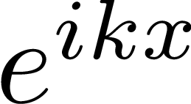
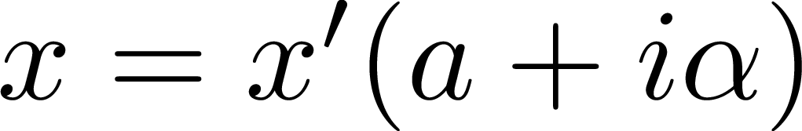
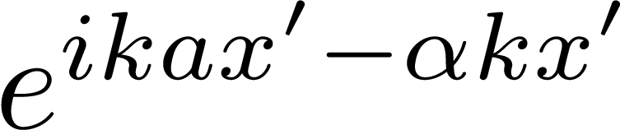
Absorbing Boundary Conditions
Outside the simulation domain, pressure is zero, therefore any incident wave on this boundary is completely reflected.
To avoid this artifact, an artificial absorbing boundary condition is used to absorb incoming wavefields.
A classic method to model absorbing bounding conditions in the FDTD method is to use a perfectly matched layer (PML).
The main idea behind the PML is:
Given a plane wave propagating in a lossless medium
Now consider the following ‘stretched’ coordinate system
Now the plane wave is , attenuated in the new ‘stretched’ coordinate system.

Slide 16

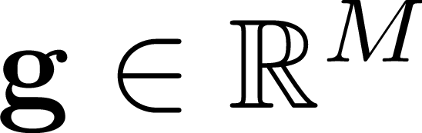


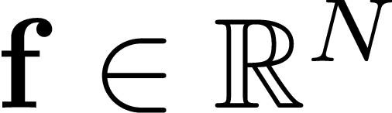




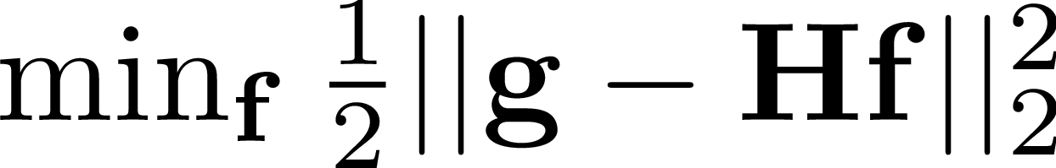

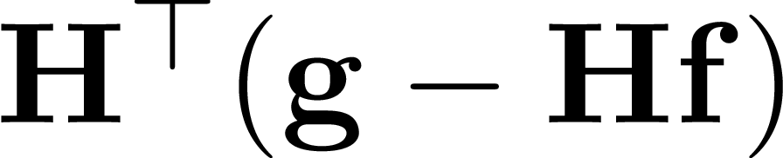
Model Based Reconstruction Approach
A PACT discrete-to-discrete imaging system can be described as
, pressure traces at transducer locations.
A typical value for (204,800 transducers x 5,000 time samples)
, sought-after initial pressure distribution (3-D image).
A typical value for (1,280 x 1,280 x 688)
, imaging operator representing an elastic wave propagation.
The image reconstruction can be formulated as given , estimate .
A classic approach is to use a gradient-based optimization approach
This can be posed as
Gradient is w.r.t is
Needs to be evaluated matrix-free!

Slide 17


Formulation of Forward Model
The matrix-vector product, , can be represented by the following process,
Apply as an initial condition on the elastic wave equation.
Propagate using the FDTD method.
The result of the matrix-vector-product is the pressure measured at the transducers.

Slide 18
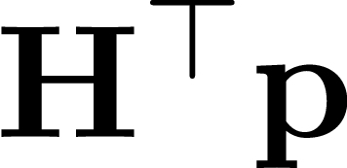

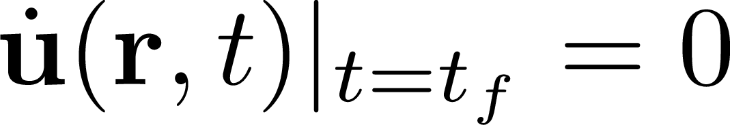

Formulation of Adjoint Model
The continuous, lossless, elastic wave equation is self-adjoint.
However, the discrete elastic wave equation is not necessarily self-adjoint.
The process for computing the adjoint matrix-vector product is similar
Apply as a forcing term at the transducer locations.
To satisfy terminus conditions, the adjoint wave equation is solved backwards in time using the FDTD method.
The solution of the adjoint-matrix-vector product is the pressure measured at

Slide 19
Current Challenges
Determining the elastic properties of the skull is difficult.
The shape of the skull can be obtained through adjunct CT/MRI data.
However, the elastic properties of the skull are subject-specific.
Solution: Joint-reconstruction of the initial pressure distribution and elastic properties of the skull.
A low dimensional model of the skull can address non-uniqueness of the reconstructed elastic parameters and initial pressure distribution (Poudel 2020).
This will improve image quality because the reconstructed elastic parameters are consistent with the measure data.
Solution: Apply a deep-learning network to compensate for the elastic properties of the skull.
A deep-learning network is used to compensate for artifacts caused model mismatches.
This bypasses the issue of estimating the elastic properties of the skull.

Slide 20
Summary
Overview of available brain imaging modalities and their limitations.
Introduced Photoacoustic Computed Tomography (PACT) and how PACT overcomes these limitations.
Challenges in transcranial PACT image reconstruction.
Formulated an imaging model based on the elastic wave equation to address these challenges.
Used the finite-difference-time-domain (FDTD) method to solve the elastic wave equation numerically.
Introduced a model-based image reconstruction framework that uses a gradient optimization approach.
Current challenges

